Slide 1
Terrarum Game Engine
The hell I’ve been doing

Slide 2
Components
Title Screen
The Actual Game
Map Maker
World
Generator
Thread
Pooler
Ingame Instance
Font
System
Terrarum
GL Post Processor
World
Modules
Audio
Renderer
Ingame Visual Renderer
Saved
Game
Loader
Module
Loader
AppLoader
Actors
UI
Blocks
Drawer
Light
Drawer
FX
Weather/ Overlay
LibGDX
OpenGL – OpenAL – Disk I/O

Slide 3
Detailed Breakdown
Ingame
Visual
Audio
Executable
Update
World
Time
Terrain
Actors
Physics
Sprite
Animation
Audio
Controller
Audio
Mixer
Renderer
AppLoader
World
Renderer
Actors
Renderer
Weather
History
Land
Ownership
Factions
Serialise
SaveGame
Post
Processor
UI
Renderer
UI
UI Manager
Font
Bitmap
Drawer
Text
Replacer
BiDi
Support
Rich Text
Color
Charset
Override
Furigana
Blocks
Drawer
Lightmap
Drawer
World FX
Weather
Drawer

Slide 4
Light Calculation
Lightmap
R | G | B | A

Slide 5


RGB- and UV Light Mixing
RGB
Lightmap.RGB
Shader
>
RGB Texture
Output Image
UV
Lightmap.AAA
Glow Texture

Slide 6
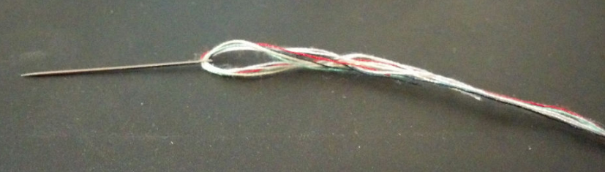
Multi-threading of Ingame
References
Boucher, Sol. "A Survey of Hardware Multithreading." A Record of the Proceedings of SIGBOVIK 2018, April -2, 2018, 131.

Slide 7
Multi-threading of Ingame
Provided by GDX
Application-related updates thread
Render thread
Thread Pool
Job
Job
Job
Job
Update
Actors
Job
Job
Job
Job
Update
World
Job
Job
Job
Job
Render
Job
Job
Job
Job
Job
Job
Job
Job
Job
Job
Job
Job
Job
Job
Job
Job
Job
Job
Job
Job

Slide 8
Inherently Multi-threaded
World generation
  Terrain generator fully benefits from multiple threads

Slide 9
The Actors

Slide 10
Actors Extended In-Game

Slide 11
The User Interface

